Slide 1
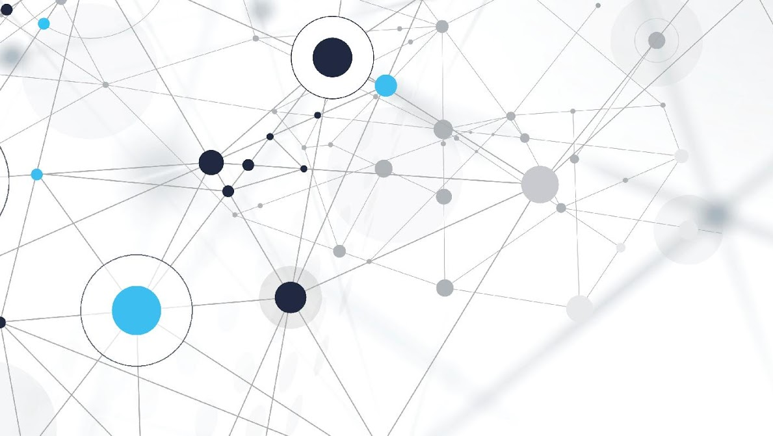
DETECTING MISINFORMATION IN IMAGES
George Mason University

Slide 2


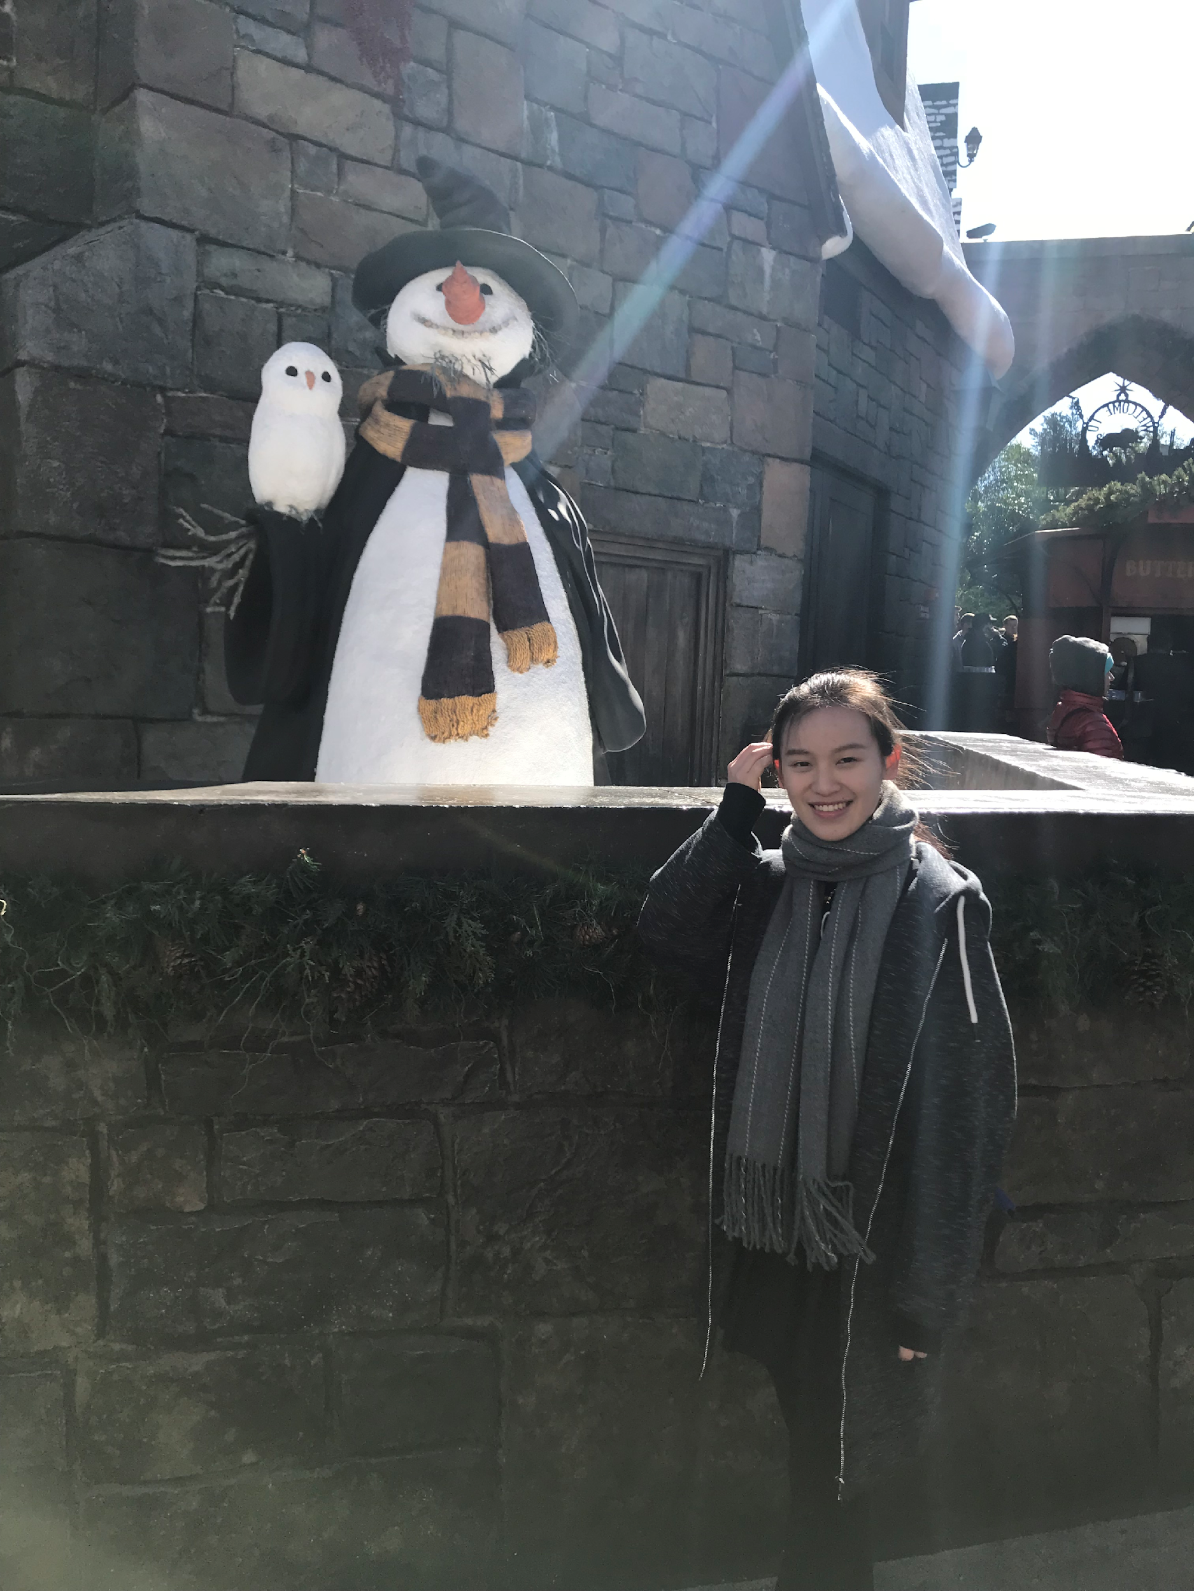
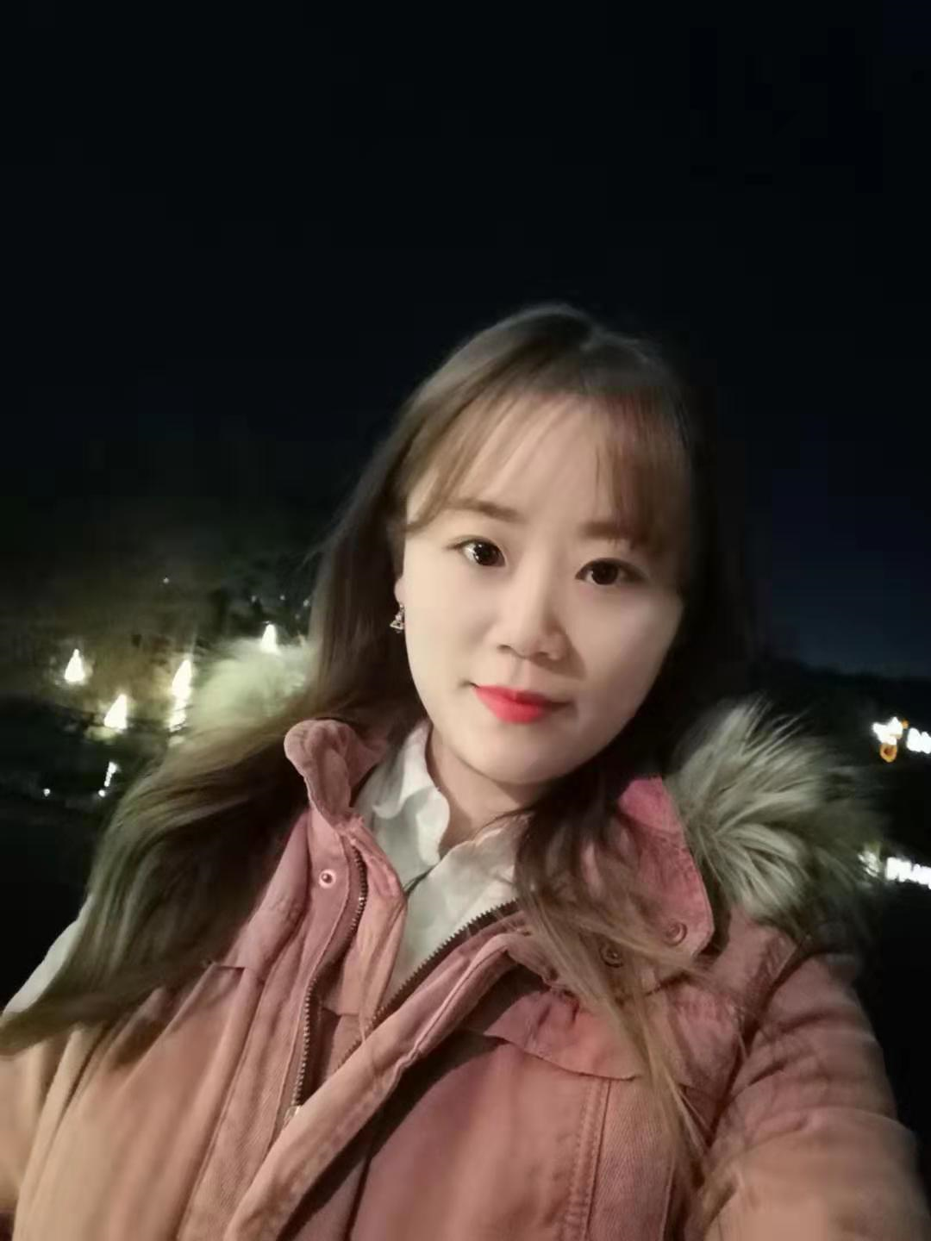

TEAM MEMBERS
Product Owner – Harshitha
Scrum Master – Amina
Developer – Bin Lu
Developer – Jing Chen
Developer – Kai Yang

Slide 3
PROBLEM STATEMENT & RISKS

Slide 4
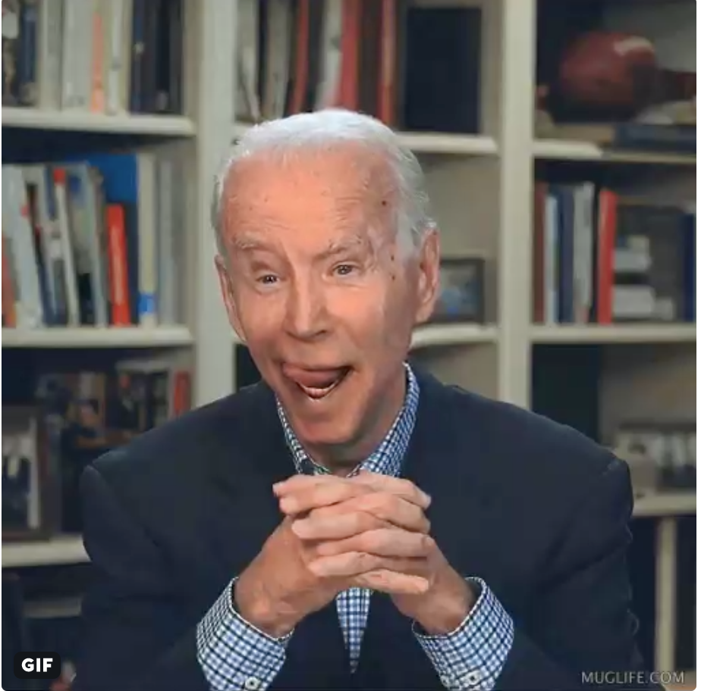
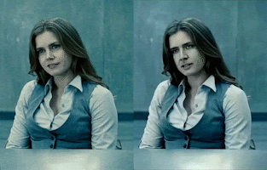
PROBLEM STATEMENT
Actress Amy Adams in the original (left) is modified to have the face of actor Nicolas Cage (right).
source: https://en.wikipedia.org/wiki/Deepfake

Slide 5
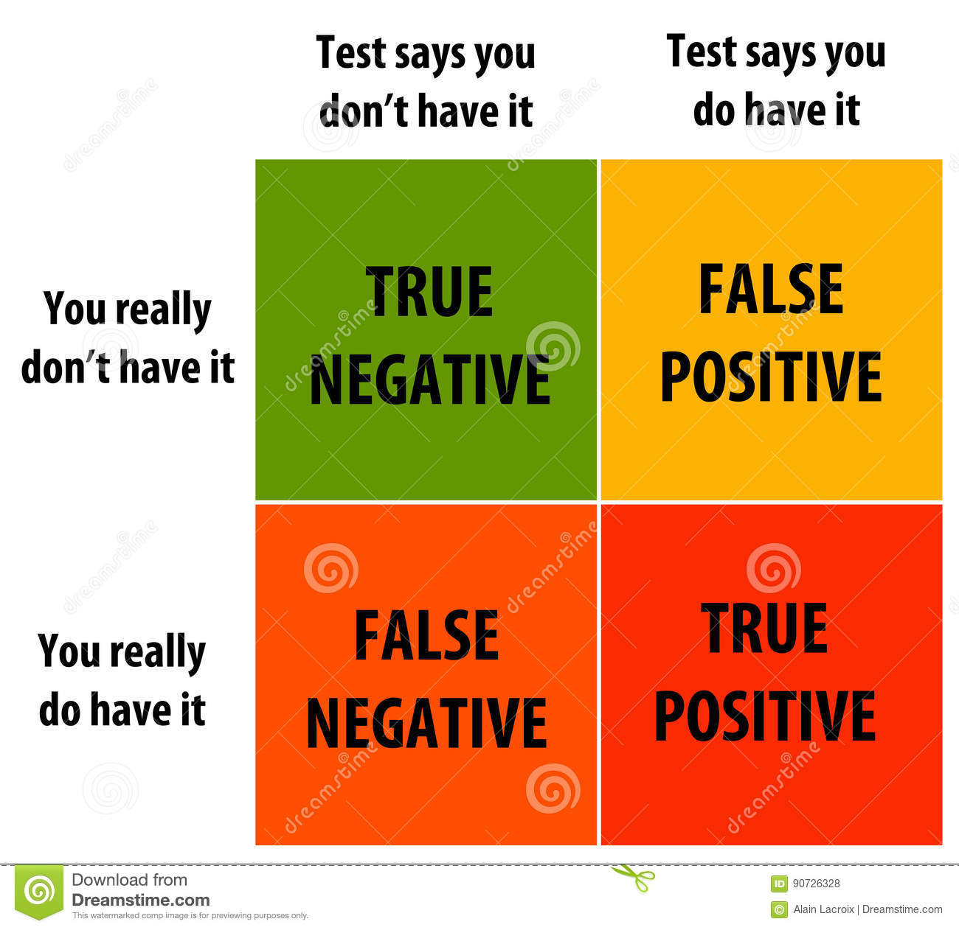
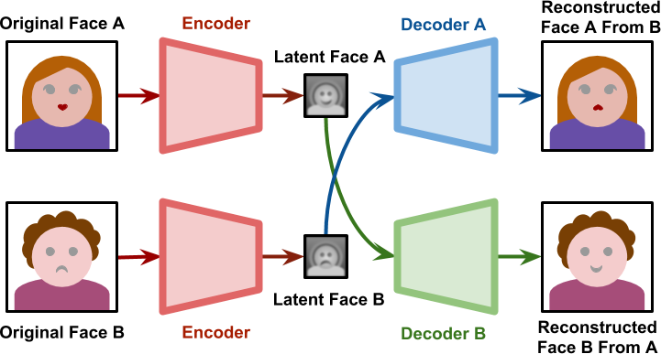
PROBLEM STATEMENT
Kaggle Competition by Facebook - Deepfake Detection Challenge - Suggested by the Sponsor to Participate.
False Positive vs. False Negative
How Deepfakes Work

Slide 6



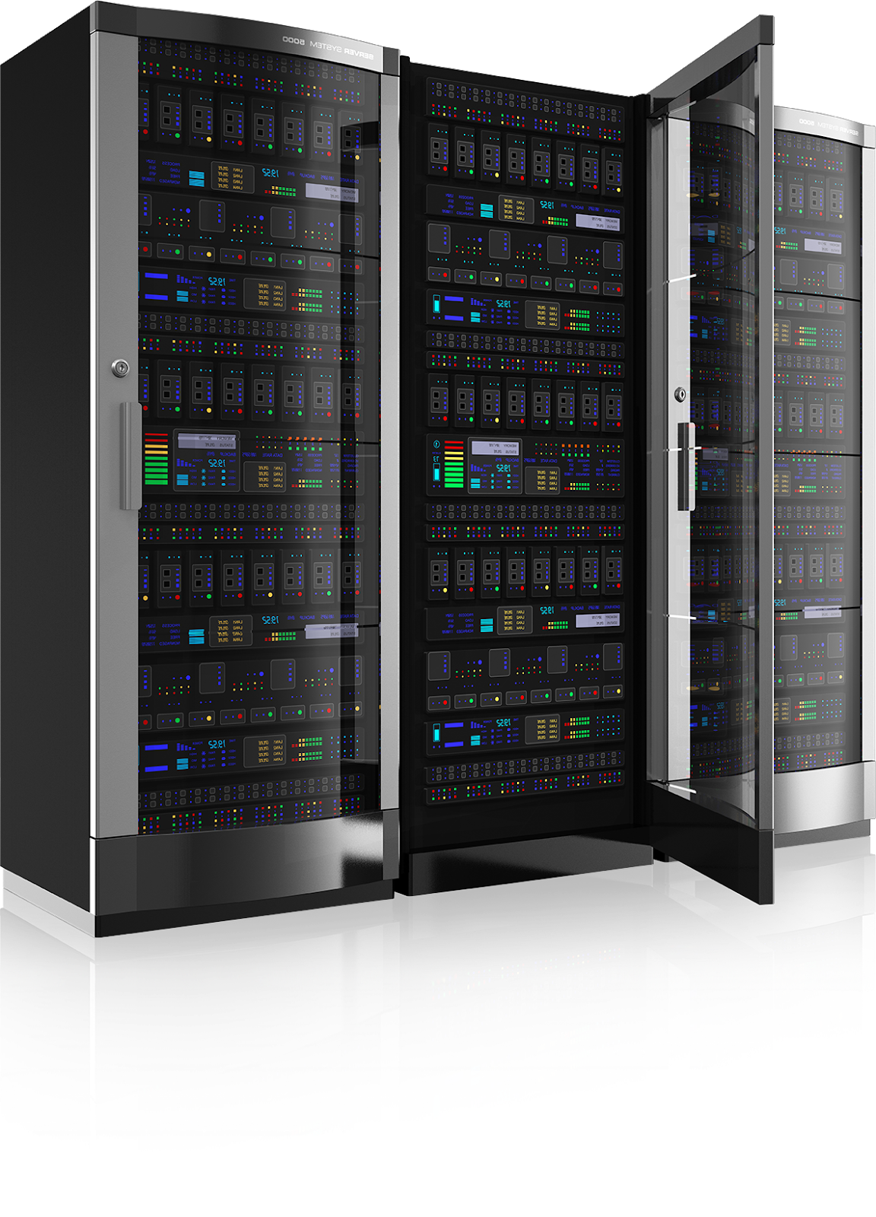
RISKS
Time
Skillset of the team
Size of the dataset
Risk of having models like CNN attacked.
Risk of having deepfakes developed with newer technologies.
Failure/Inability to use one or more prototypes.
Issue with Argo Cluster

Slide 7
DATASET

Slide 8



DATA SOURCE- FACEBOOK’S DEEPFAKE CHALLENGE
Size of dataset
480 GB
Storage
Argo Cluster, Google Colab
Format
Video and JSON File

Slide 9
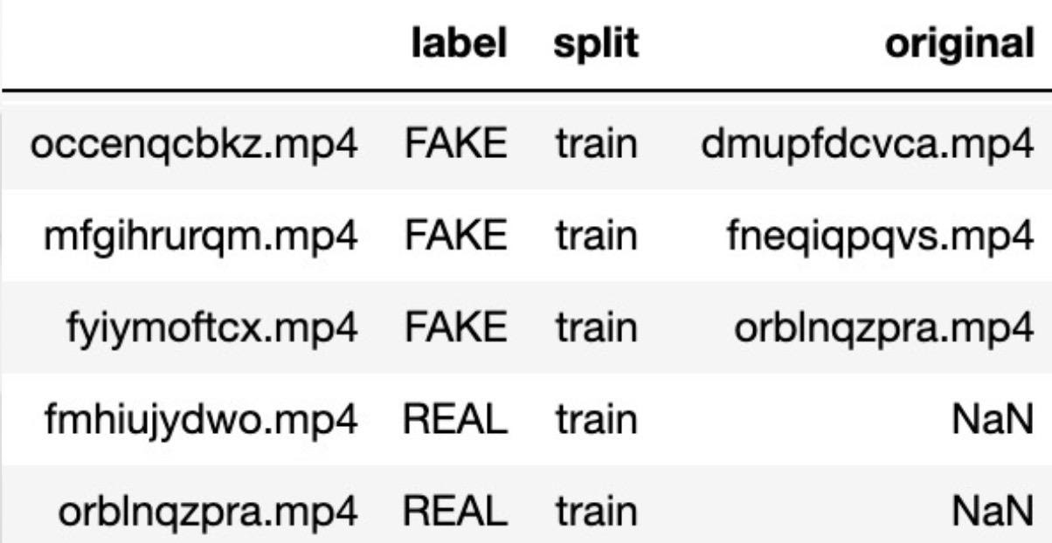
METADATA

Slide 10
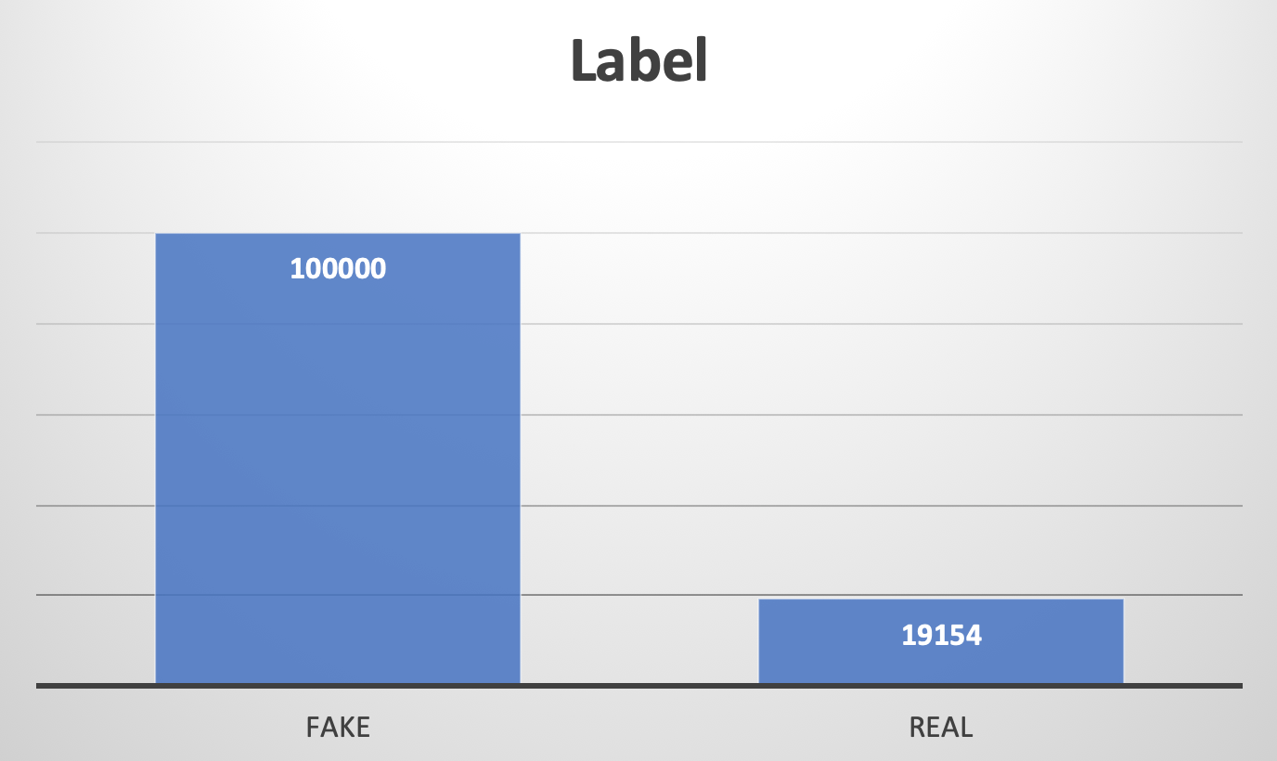
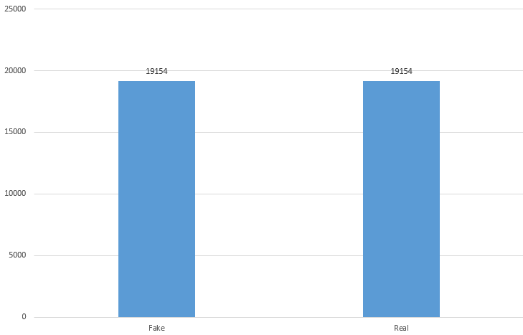
METADATA - UNBALANCED
Resampling Technology

Slide 11
ANALYTICS AND ALGORITHMS

Slide 12
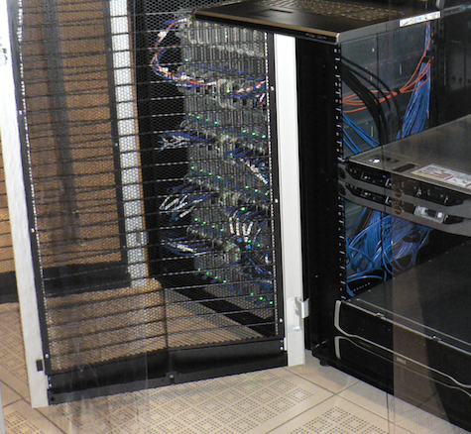

ARGO CLUSTER & GOOGLE COLAB PRO

Slide 13
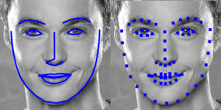
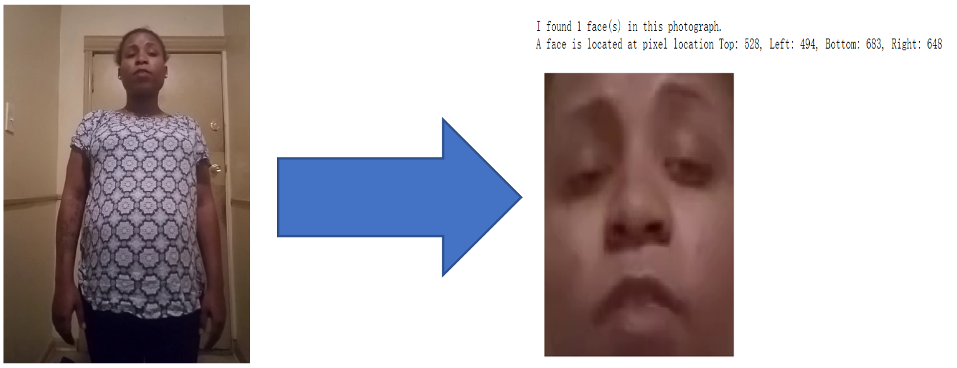
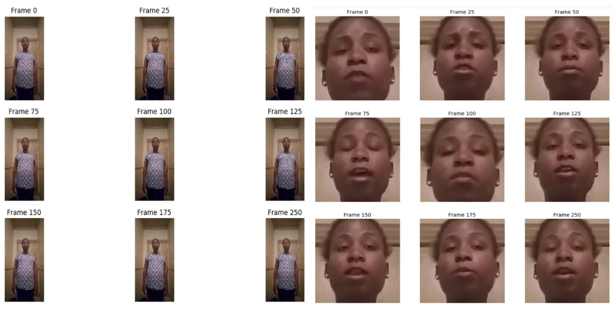
IMPLEMENTATION
Landmark Recognition
Facial Detection
Frames Extraction

Slide 14
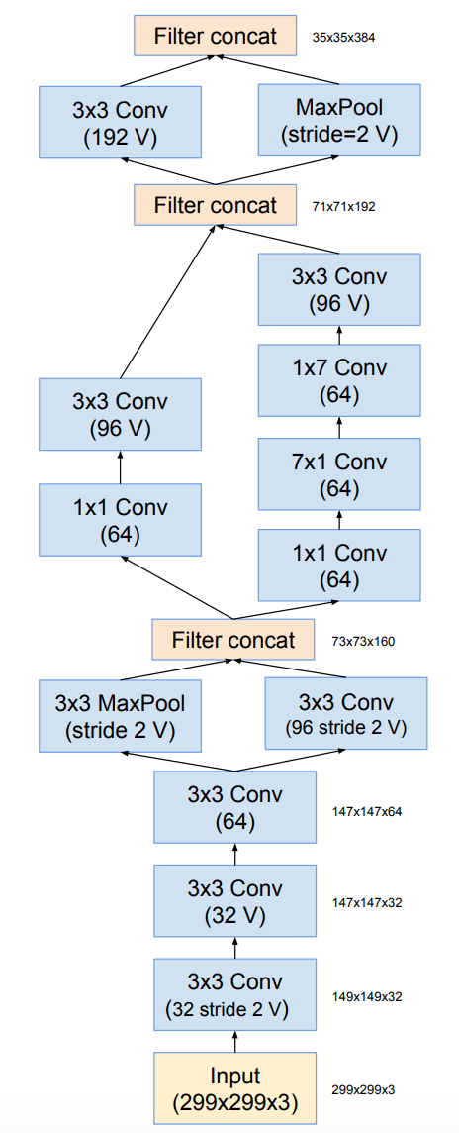
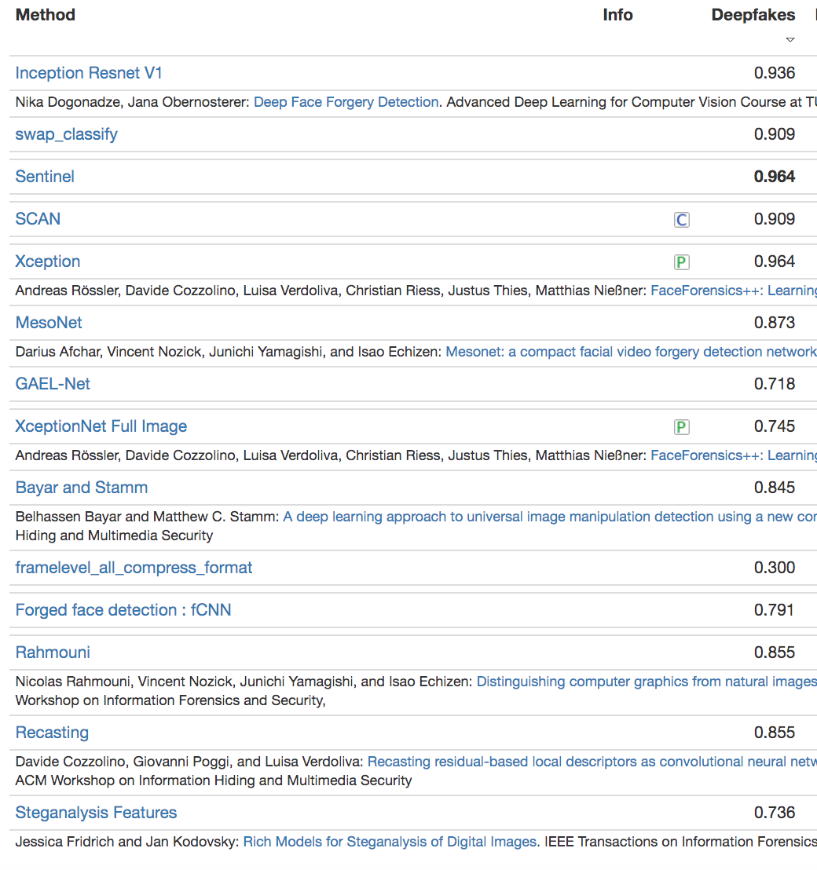
INCEPTION-RESNET
FaceForensics++
Schema for Inception-ResNet v2

Slide 15
VISUALIZATION

Slide 16
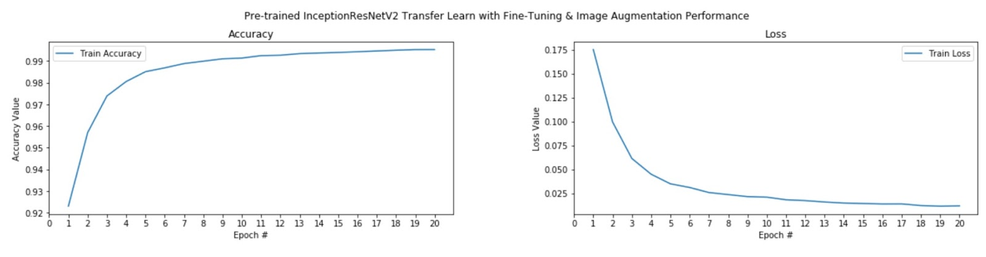
MODEL TRAINING
Accuracy of Epoch 20: 99.53%
Loss of Epoch 20: 1.17%

Slide 17
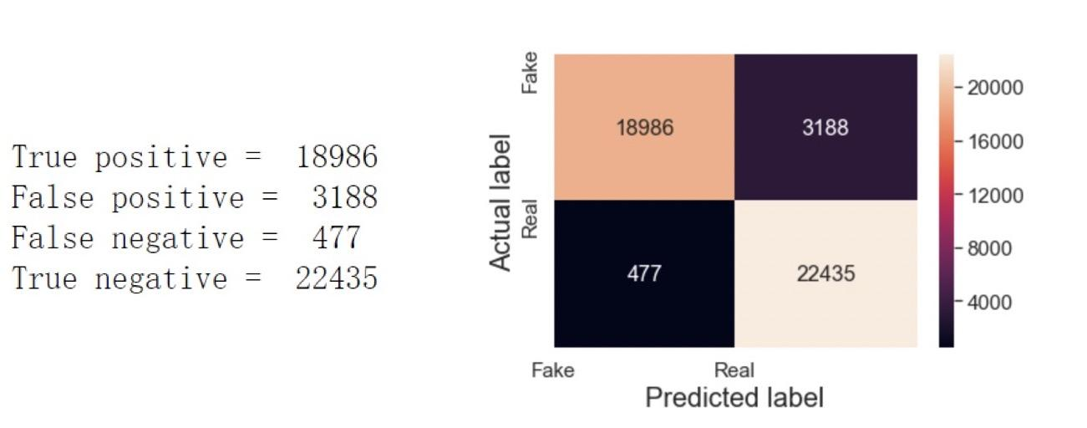
MODEL TESTING

Slide 18
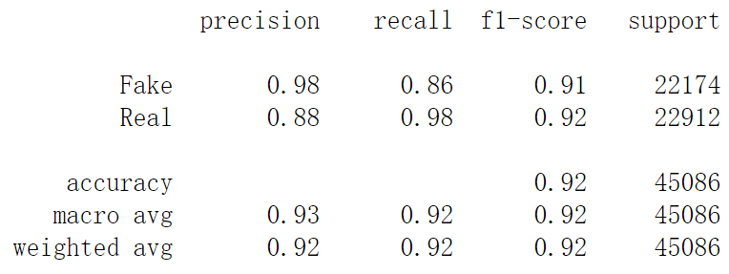
MODEL TESTING

Slide 19
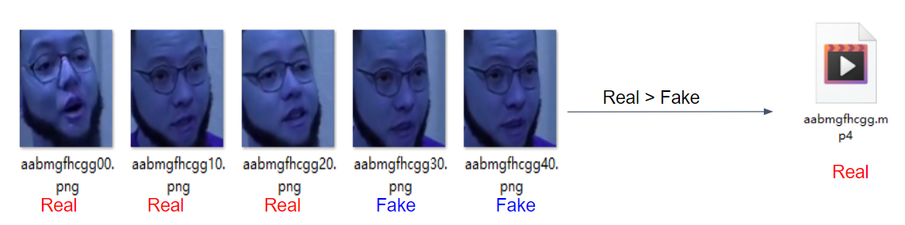
VIDEO PREDICTION
Results:

Slide 20
SUMMARY

Slide 21



Summary
Unbalanced data sets can be resolved by random resampling
The combination of ARGO Cluster and Google Colab can effectively handle large data sets
The Inception-ResNet V2 model has high performance in detecting deepfake.
The accuracy rate in 20 epochs： 0.9953 of model training; 0.92 of model testing

Slide 22
FUTURE WORK
Audio Processing
Time Series
Long Short-Term Memory
Datasets
Find datasets from different resources
Look for datasets with higher quality
Methodology chosen
Try to detect by analyzing eye blinking, head movements and so on.

Slide 23
REFERENCES
[1] Chesney, R., and Citron, D. (2019). Deepfakes and the new disinformation war: The coming age of post-truth geopolitics. Foreign A airs, 98, 147.
[2] Hsu, C. C., Zhuang, Y. X., and Lee, C. Y. (2019). Deep fake image detection based on pairwise learning. Preprints, 2019050013.
[3] Y. Li, M.-C. Chang and S. Lyu, "In Ictu Oculi: Exposing AI Generated Fake Face Videos by Detecting Eye Blinking," 2018 IEEE International Workshop on Information Forensics and Security (WIFS), 31 1 2019.
[4] P. Korshunov and S. Marcel, "DeepFakes: a New Threat to Face Recognition?," Assessment and Detection, p. crarXiv:1812.08685v1 (cs.CV), 20 12 2018.
[5] A Recurrent Neural Network Glossary: Uses, Types, and Basic Structure. Retrieved from:https://missinglink.ai/guides/neural-network-concepts/recurrent-neural-network-glossary-uses-types-basic-structure/

Slide 24

THANK YOU!
Any questions?

